Slide 1
PHP
+
Framework
+
MVC

Slide 2
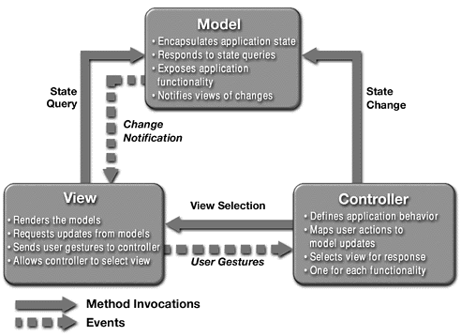

Slide 3
What
is
Framework?

Slide 4
Common code - Generic functionality
Extensible - Specific functionality
Unlike library – Flow Dictated by Framework

Slide 5
Reusable Design- May include:
Support programs
Code libraries
Tools to develop and glue different components

Slide 6
Why
a
Framework?

Slide 7
I am lazy enough to write long codes,
NAAAH...

Slide 8
Technical Aspects:
Proven Architecture
Efficient (Code Re-usability)
Scalable
Extensible
Modularity

Slide 9
Developer Aspects:
Easier maintenance
Shorter development times.
Flexible and less error-prone

Slide 10
Focus => Specialized Functionality
NOT
Architecture
Common Tools
Work Flow

Slide 11
How
to choose
Framework?

Slide 12
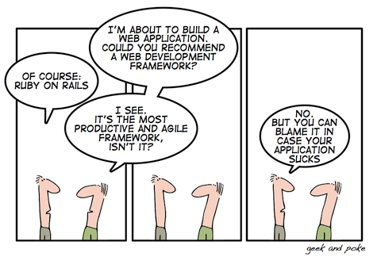

Slide 13
Ofcourse,
NOT

Slide 14
Technical Aspects:
Types of application, Types of framework
Technical features of the framework
Ease of development
Ease of testing
Tool support

Slide 15
Viability Aspects:
Frequent release
Future enhancement
Maturity – real life usage cases
Proven market place?
Production Environments?

Slide 16
So, which one?

Slide 17
The one which answers most of the above questions.

Slide 18
PHP
+
Framework
+
MVC
CakePHP

Slide 19
Free Open Source
Rapid Application Development
Active Community
Compatibility with PHP4 and PHP5
Project Age - 5yrs

Slide 20
MVC
Scaffolding
Validation
Data Sanitation
ACL
Components
Helpers
Security
Session
Caching

Slide 21
Easy Installation – 2 Mins
Easy Debugging
Integrated Unit Testing

Slide 22
Setting Up Cake:
Setup Database Configuration
CakePHP supports database drivers:
• mysql
• postgres
• sqlite
• pear-drivername (e.g. pear-mysql)
• adodb-drivername

Slide 23
Models:
• Access point to a certain table in the database
• Contain data validation rules, association
information, and methods specific to the table
• Extends AppModel

Slide 24
Models:
• Table name in plural, like "users" and models in singular “user”.
• Mandatory Primary key named 'id'.
• Foreign keys naming: 'article_id'. (singular-table-name_id).
• 'created' / 'modified' column are automatically populated.

Slide 25
Controllers:
• Manage the logic for a certain section or a single model.
• Include any number of actions
• Actions are functions used in your web application to display views
• Extends AppController

Slide 26
class VideosController extends AppController
{
function view($id)
{
//action logic goes here..
}
function rent($customer_id, $video_id)
{
//action logic goes here..
}
function search($query)
{
//action logic goes here..
}
}
example URLs:
http://www.example.com/videos/view/253
http://www.example.com/videos/rent/5124/0-2352

Slide 27
Controller action as a webservice
• Set WEBSERVICES in /
app/config/core.php to 'on'
• Structure the logic in controller just as you normally would

Slide 28
Views:
a page template, usually named after an action.
view for PostsController::add() would be found at /app/views/posts/add.thtml.
simply PHP files, so you can use any PHP code inside them

Slide 29
Views:
data is passed as an array called $data
data handed to the view using set() in the controller is also available in view.
HTML helper is available in every view by default
layout contains presentational code that wraps around view. Usually, common for one controller.

Slide 30
Scaffolding:
• Way of getting the early parts of developing a web application started.
• Analyze database tables and creates standard lists, add, delete, edit.
• Add scaffolding by adding the $scaffold variable to controller.

Slide 31
Components:
Components are used to aid controllers in specific situations.
A Reusable code which seamlessly sits inside Controller
Sample Component Class
class FooComponent extends Object
{
var $someVar = null;
var $controller = true;
function startup(&$controller)
{
// Perform controller initialization here.
}
function doFoo()
{
$this->someVar = 'foo';
}
}

Slide 32
add the following code in your controller's definition:
var $components = array('Foo');
Inside of that controller you could now use:
$this->Foo->doFoo();

Slide 33
Helpers:
Common functions to format views.
Quick-and-easy creation of web forms
image($path, $htmlAttributes, $return = false);
Renders an image tag.
tableHeaders($names, $tr_options, $th_options);
create a formatted table header.

Slide 34
Other Helpers:
AJAX
Javascript
Number
Text
Time
Cache
(You can create your own helper.)

Slide 35
Data Validation:
Data in a Model conforms to the business rules.
Example /app/models/user.php
<?php
class User extends AppModel
{
var $name = 'User';
var $validate = array(
'login' => '/[a-z0-9\_\-]{3,}$/i',
'password' => VALID_NOT_EMPTY,
'email' => VALID_EMAIL,
'born' => VALID_NUMBER
);
}
?>

Slide 36
Plugins:
Distribute combination of controllers, models, and views as package.
Example: Pizza Ordering Filesystem Layout
/app
/plugins
/pizza
/controllers <- plugin controllers go
here
/models <- plugin models go here
/views <- plugin views go here
/pizza_app_controller.php <- plugin's AppController,named after the plugin
/pizza_app_model.php <- plugin's AppModel, named after the plugin

Slide 37
ACL:
Access Request Objects (AROs) and
Access Control Objects (ACOs)
$aro = new Aro();
// Create ARO
$aro->create( 1, null, 'Bob Marley' );
// Create Groups
$aro->create(0, null, 'Artists');
//Hook ARO with Group
$aro->setParent('Artists', 'Bob Marley');

Slide 38
Creating ACOs and assigning permissions
$aco = new Aco();
//Create some access control objects:
$aco->create(1, null, 'Electric Guitar');
$this->Acl->allow('Abraham Lincoln', 'Electric Guitar','read');

Slide 39
// Check Access
$access =
$this->Acl->check($this->Session-> read('user_alias'), $aco, $action = "*");
//access denied
if ($access === false)
{
echo "access denied";
exit;
}

Slide 40
Data Sanitation:
Makes User Given Data Safe for use in SQL and
HTML
// First, include library and instantiate:
uses('sanitize');
$mrClean = new Sanitize();
$badString = ";:<script><html>< // >@@#";
echo $mrClean->paranoid($badString);
// output: scripthtml
echo $mrClean->paranoid($badString, array(' ', '@'));
// output: scripthtml @@

Slide 41
Sessions:
Here are some of the functions you'll use most:
check ($name);
del ($name);
delete ($name);
Error ();
flash ($key = 'flash');
read ($name);
renew ();
;

Slide 42
Security:
RequirePost()
class ThingsController extends AppController
{
var $components = array('Security');
function beforeFilter()
{
$this->Security->requirePost('delete');
}
function delete($id)
{
// This will only happen if the action is called via an HTTP POST request
$this->Thing->del($id);
}
}

Slide 43
5 Mins
Blog Tutorial
with
Unit Testing

